Slide 1

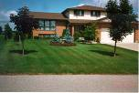
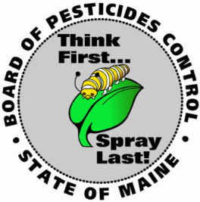
Home Pesticide Use
Risks & Benefits
John Pietroski
Maine Board of Pesticides Control
28 State House Station
Augusta ME 04333-0028
(207) 287-2731
john.t.pietroski@maine.gov
University of Maine
Cooperative Extension
August 27, 2019
Master Gardener
Notes:
Introduction
Clickers
People will ask you about pesticides – be careful about recommendations
Think first spray last
IPM
ok

Slide 2
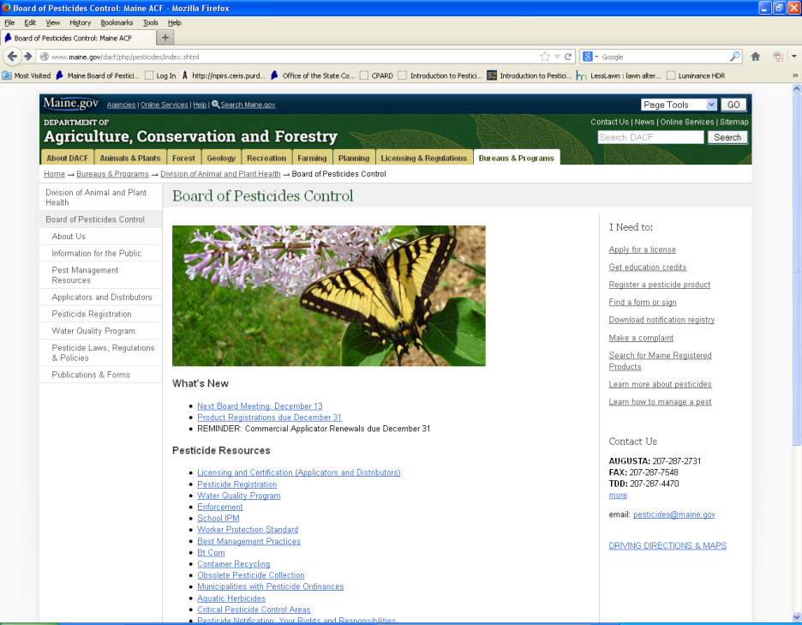
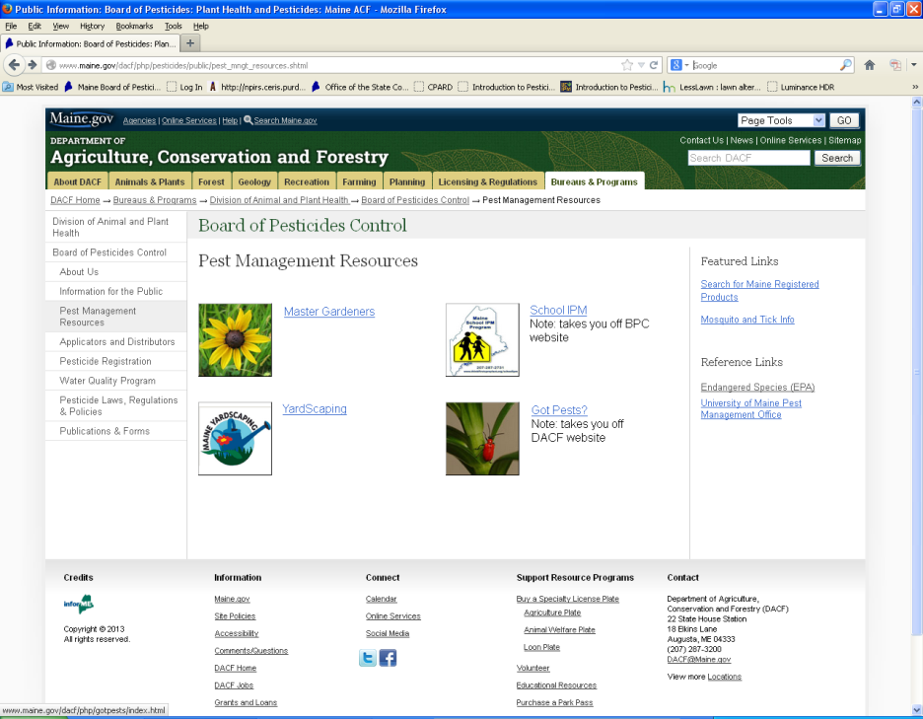
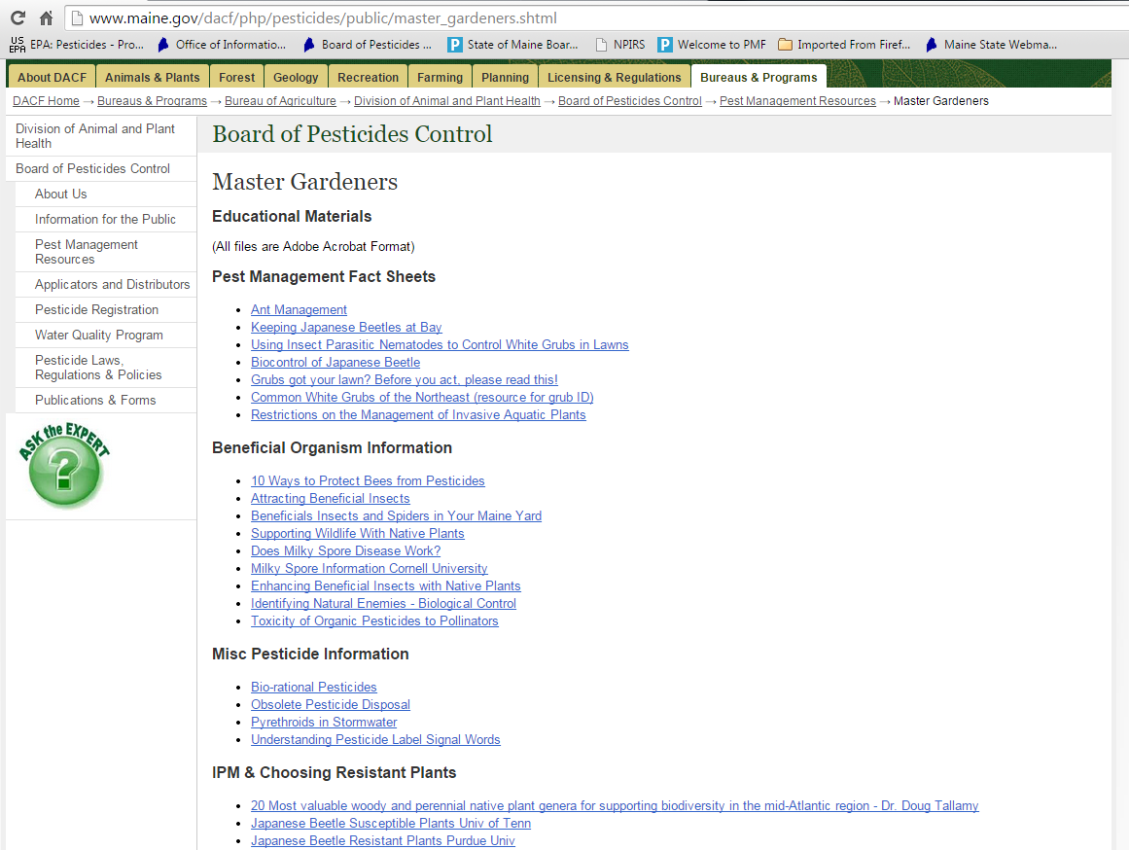
Handouts on-line
www.thinkfirstspraylast.org
Notes:
Handout magnets
Large selection of pest management resources
Handouts on our website
ok

Slide 3
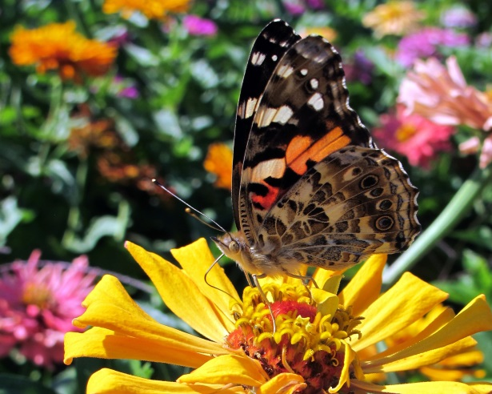
Which type of gardener are you?
Black thumb
Novice
Intermediate
Experienced
Greenest thumb
Notes:
Clickers
Chance to try clickers
ok

Slide 4
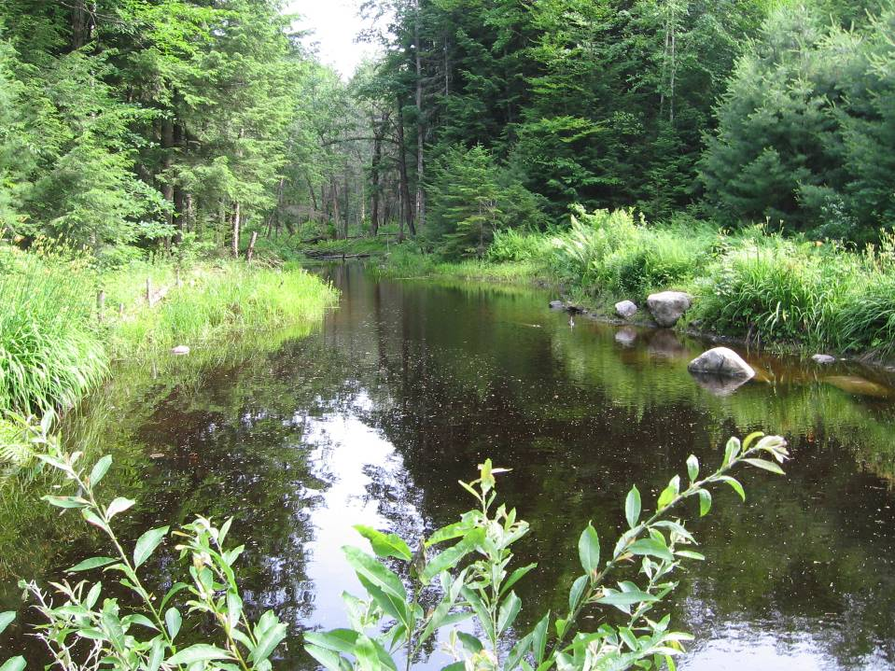
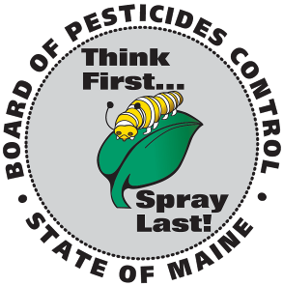
Have you ever heard of the Board of Pesticides Control (BPC)?
Yes
No
Notes:
Question
We agency regulates pesticides
Advice
Toxicologist
ok

Slide 5
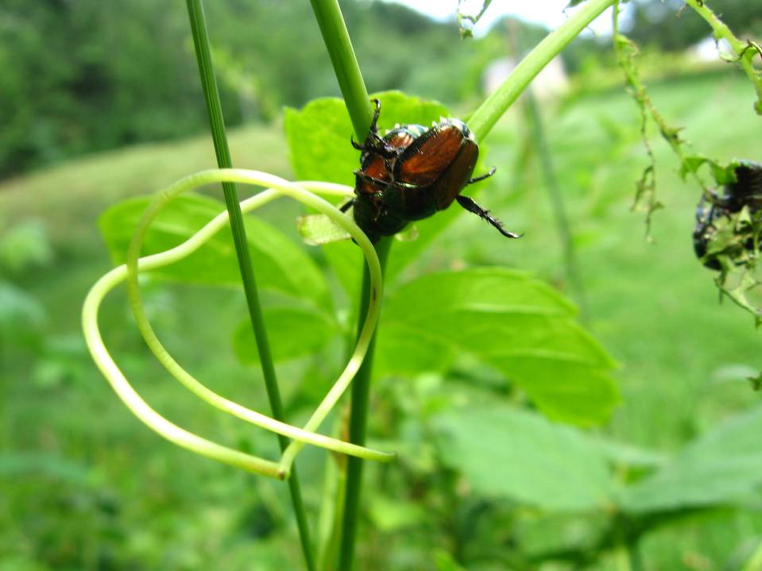
What is your opinion of the BPC?
Strongly favorable
Favorable
Neutral
Unfavorable
Strongly unfavorable
Notes:
Question
No tracking!
Discuss BPC mission IPM
Small staff
Hard to reach public
Risk verses benefits
We cannot make recommendations
ok

Slide 6
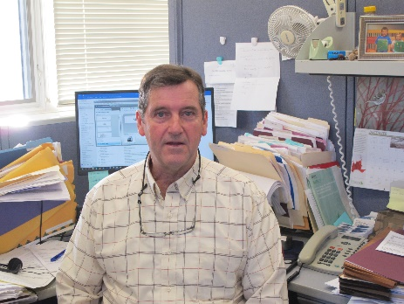
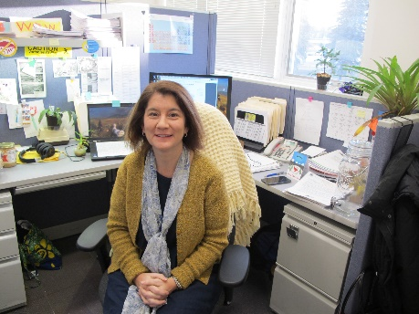
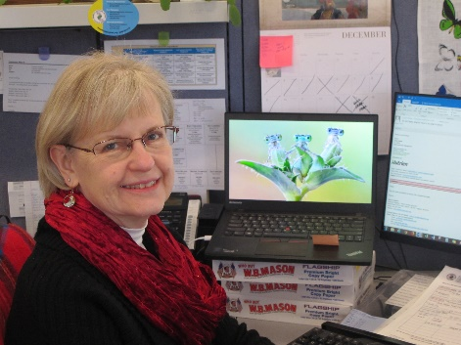

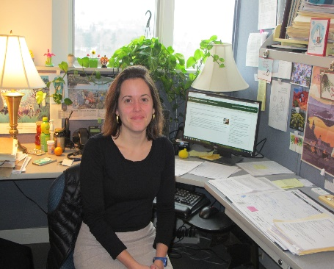
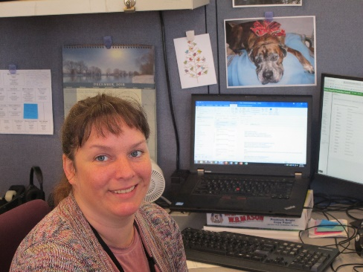
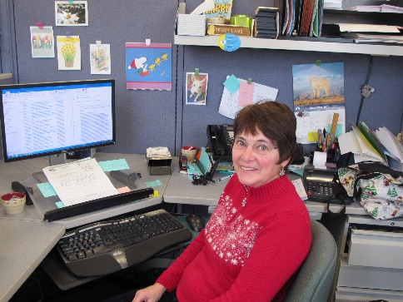
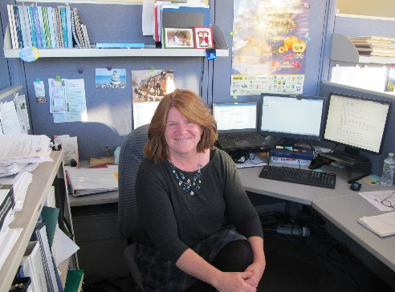
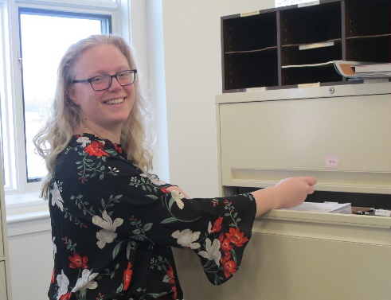
Ray Connors
Manager of Compliance
Raymond.G.Connors@Maine.Gov
Pam Bryer
Pesticide Toxicologist
Pamela.J.Bryer@Maine.Gov
Mary Tomlinson
Pesticide Registrar & Water Quality
Mary.E.Tomlinson@Maine.Gov
John Pietroski
Manager of Pesticide Programs
John.T.Pietroski@Maine.Gov
Megan Patterson
Director
Megan.L.Patterson@Maine.Gov
Amanda Couture
Certification & Regulation Specialist
Amanda.Couture@Maine.Gov
Peggy Lamb
Office Manager
Peggy.Lamb@Maine.Gov
Anne Chamberlain
Policy & Regulations
Anne.Chamberlain@Maine.Gov
Katelyn Kiel
Administrative Assistant
Katelyn.Kiel@Maine.Gov
Board of Pesticides Staff 2019
Jan Betts
Secretary
207 287-2157
Jan.Betts@Maine.Gov

Slide 7

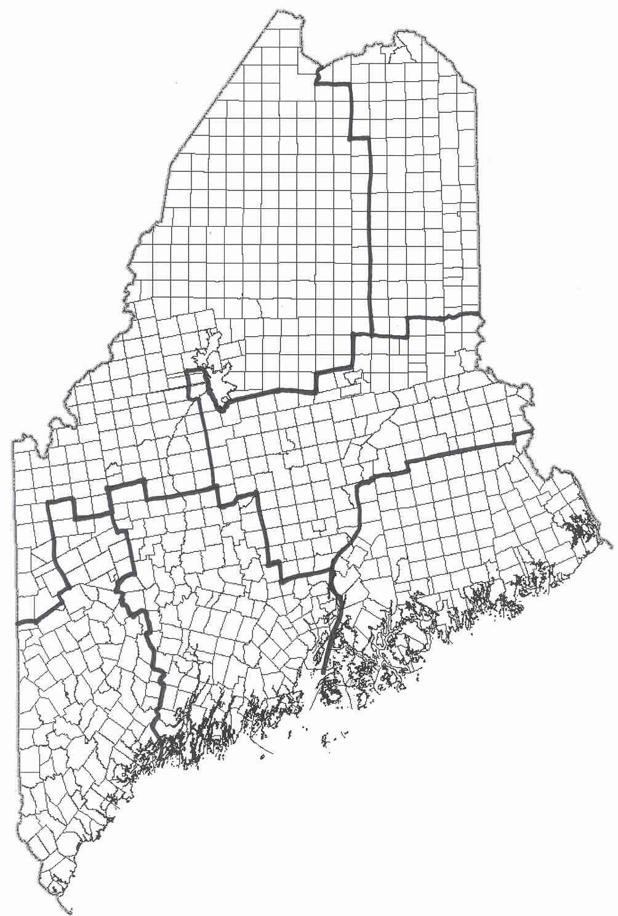


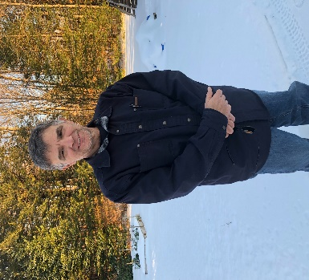
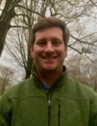
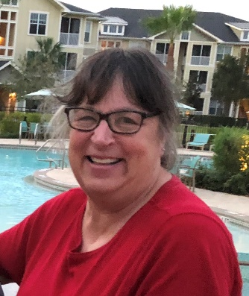

The State of Maine is divided into six districts. Five of the districts are covered by a Pesticide Inspector.
District 6--No Inspector’s Land
Ray Connors
Raymond.G.Connors@Maine.Gov
Compliance Manager
District 5 – Aroostook
Keith Brown
Keith.R.Brown@Maine.Gov
6
5
District 2 – Midcoast
Lucien Saucier
Lucien.Saucier@maine.Gov
District 4 – Central Maine
Nathan Thompson
Nathan.Thompson@Maine.Gov
4
3
2
District 1 – Southwest
Alex Peacock
Alexander.R.Peacock@maine.gov
1
District 3 - Downeast
Heidi Nelson
Heidi.D.Nelson@Maine.Gov
Board of Pesticides Inspectors 2019

Slide 8
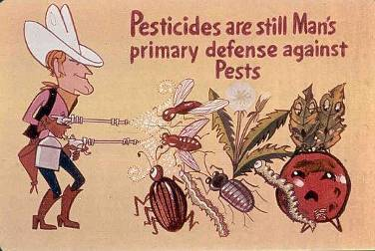
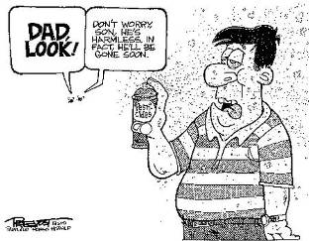
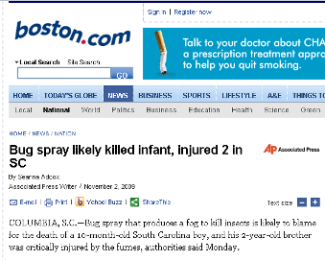
How we see ourselves using pesticides
Unfortunately, a not so uncommon result from our use of pesticides
Notes:
Pesticides are a tool in the tool box
No pesticide poisonings in years
Arsenic in new Sweden
Two dogs from poisoning birds
ok

Slide 9
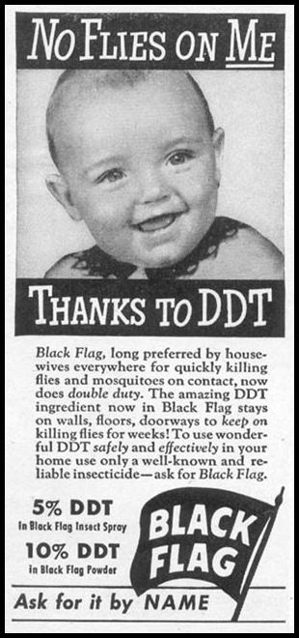
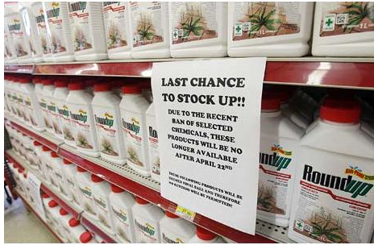
We’ve relied on pesticides in the past and still rely on them today
Notes:
Ok
Baby real ad
Ddt not very toxic to humans
Used in WW II and Korean war to treat for lice
Second picture from Toronto Canada banning pesticides

Slide 10
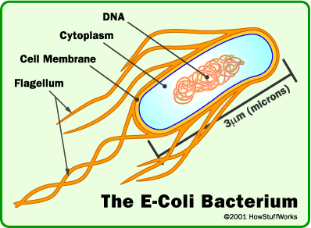
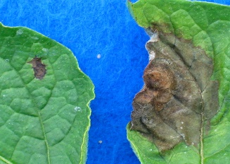
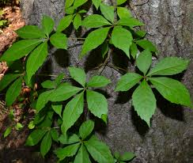
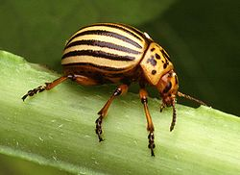
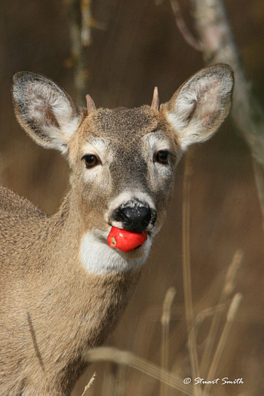
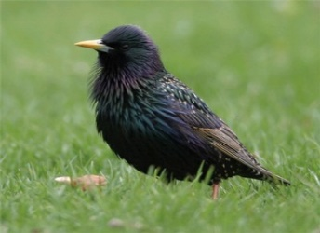
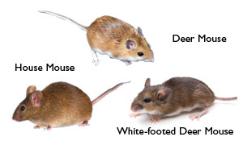
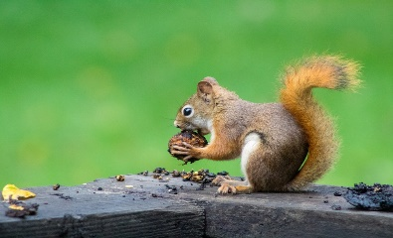
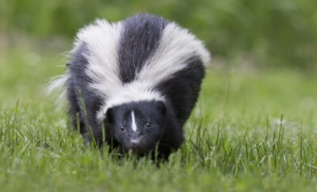
What is a pest?
E-Coli
Bacteria, viruses (germs)
Fungi, plant diseases
Weeds
Insects, mites, etc.
Vertebrates
Potato Blight
Virginia Creeper
Potato Beetle
White Tail
Starling
Mice
Squirrels
Skunks
Notes:
ok

Slide 11
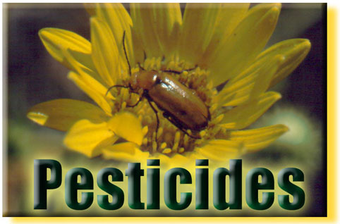
What is a pesticide?
Any substance or mixture of substances intended for:
  preventing,
  destroying,
  repelling, or
  mitigating any pest
And any plant regulator, defoliant or desiccant.
  Does not include fertilizers or nutrients
  Does not include beneficial organisms
  Does not include traps or mechanical means
Notes:
Go into details
ok

Slide 12
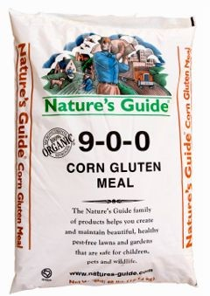
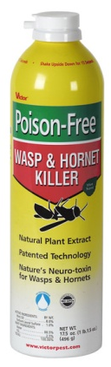
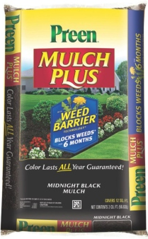

Which are pesticides?
No endorsement intended or implied
A.
B.
C.
D.
Notes:
Can answer as many as you want
Read the label
Pesticides – insecticides herbicides, fungicides, rodenticides, miticides,
Corn gluten meal is a fertilizer which has pre-emergent herbicidal tendencies.
Good Natured Premium Corn Gluten Meal is a high nitrogen (9-0-0) slow release fertilizer, and if applied at the right times in the spring and fall, helps control weed seed germination (affects any seed actually).
ok

Slide 13
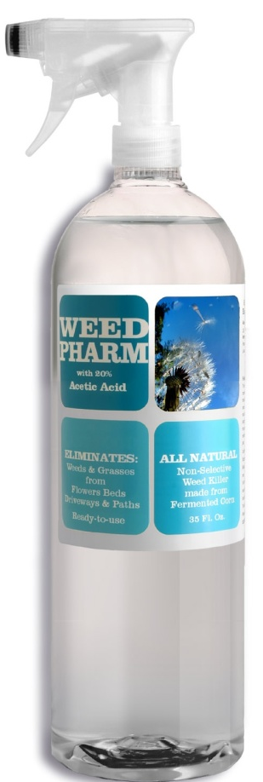

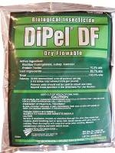
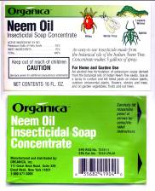

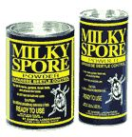
Maine pesticide use more common than perceived
No endorsement intended or implied
Notes:
Chemical pesticide
Everything is a chemical or element
Pesticides all shapes and sizes
ok

Slide 14
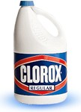
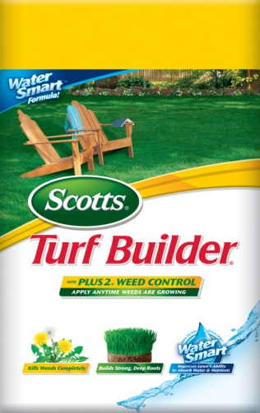
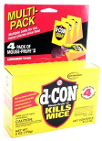
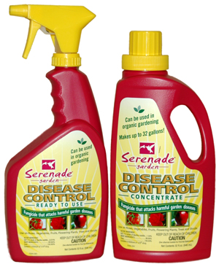
What are pesticides?
Bleaches, Lysol, pine oil
Weed & Feed, Roundup
Rat & mouse baits
Plant disease controls
No endorsement intended or implied
Notes:
ANY SUBSTANCE USE TO CONTROL A PEST
Bleach disinfectant
Intent with bleach
Mechanical traps no Bait yes
Key work bait
Repellants are pesticides
ok

Slide 15
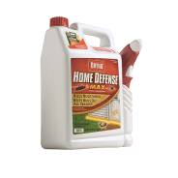
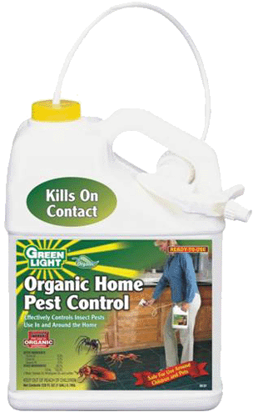

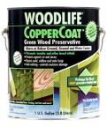
What are Pesticides?
Sevin, Pyrethroids, Raid
“Organics” like pyrethrum
Biological Controls
Wood preservatives
No endorsement intended or implied
Notes:
Pyrethrum refers to the Pyrethrum daisy (Chrysanthemum cinerariifolium) from which the insecticidal compound is extracted. Also nicknamed Dalmatian chrysanthemum, this perennial daisy is loaded with chemicals called pyrethrins that are toxic to insects. Since it is directly extracted from a plant, and since it is considered nontoxic to humans, pyrethrum is approved in the U.S. for use on certified organic farms.
Milky Spore comes in a powder and consists of a bacteria. The first reason not to use milky spore was the design, it was manufactured to control ONLY Japanese beetle grubs- unfortunately there are many more! Other turf damaging grubs in NH & VT include Asiatic beetles, European and masked chafers, June and May beetles and armyworms. So now you understand that even if milky spore could work, you would be controlling one grub out of many, not good odds.
ok

Slide 16

















These are Pesticides?
Plant incorporated protectants
  Have the Bt. Crystalline protein engineered into them
No endorsement intended or implied
Notes:
Plants expressing pesticides
Plants resistant to pesticides are NOT pesticides
Sweet and field corn only in Maine
ok

Slide 17

EPA exempt pesticides
Some pesticides have been deregulated by EPA
  Exempt from Federal registration
  Must be registered by State of Maine
  Exempt from toxicity testing
  NOT risk free
Ingredients in some of these products:
Rosemary oil
Peppermint oil
Thyme oil
Clove oil
Wintergreen oil
Cinnamon oil
No endorsement intended or implied
Notes:
Class of pesticides deregulated by EPA
Still regulated by Maine
25 b products
No toxicity testing
Can be highly toxic
ok

Slide 18

What are the risks?
Peppermint oil –
  highly toxic,
  use in infants or children is not recommended, when inhaled, due to the potential toxicity of the product
  doses of menthol over 1 g/Kg body weight may be deadly
  causes dermatitis,
Cinnamon oil –
  powerful irritant and
  even worse sensitizer
  cinnamon contains coumarin, the parent compound of warfarin, a medication used to keep blood from clotting
http://www.naha.org/ https://nccih.nih.gov/health/cinnamon
No endorsement intended or implied
Notes:
Actives ingredients can be toxic
Route of exposure different
Breathing, bloodstream concentrate riskier
ok

Slide 19

Caveat emptor!
Notes:
Caveat emptor is Latin for let the buyer beware, meaning the buyer assumes the risk in a transaction. ... Buyers purchase goods as is and have little or no recourse if those goods turn out to be defective
Don’t have to prove efficacy
Ok
Now we are seeing Browntail moth products
ok

Slide 20

What about home remedies
Home chemistry is not recommended by the BPC
Many of the materials used seem “safe” because we eat them or use them on our skin
Exposure routes may be different
What we eat may not be safe to breathe
Example
6. Eucalyptus oil
A great natural pesticide for flies, bees and wasps. Simply sprinkle a few drops of eucalyptus oil where the insects are found. They will all be gone before you know it
Notes:
We don’t recommend
Different routes on exposure
Only legal on your property
ok

Slide 21

From Medline Plus – NLM NIH
http://www.nlm.nih.gov/medlineplus/druginfo/natural/700.html
Eucalyptus oil is POSSIBLY UNSAFE when applied directly to the skin without first being diluted. Eucalyptus oil is LIKELY UNSAFE when it is taken by mouth without first being diluted. Taking 3.5 mL of undiluted oil can be fatal. Signs of eucalyptus poisoning might include stomach pain and burning, dizziness, muscle weakness, small eye pupils, feelings of suffocation, and some others. Eucalyptus oil can also cause nausea, vomiting, and diarrhea.
Children: Eucalyptus oil is LIKELY UNSAFE for children. It should not be taken by mouth or applied to the skin. Not much is known about the safety of using eucalyptus leaves in children. It’s best to avoid use in amounts larger than food amounts.
Surgery: Since eucalyptus might affect blood sugar levels, there is concern that it might make blood sugar control difficult during and after surgery. Stop using eucalyptus at least 2 weeks before a scheduled surgery.
Notes:
Can have impact on blood sugar
Concerns around exposures
Stress 3.5 ml
ok

Slide 22





What products are NOT pesticides?
Insect parasitic nematodes
Rodent or insect traps
Beneficial insects or mites
No endorsement intended or implied
Notes:
Multi-cellular organism
Mechanical traps – NO BAIT
Multi-cellular
ok

Slide 23


What does registration mean?
Not a safety guarantee
Reasonable certainty of no harm, but NOT risk free
Must read and follow the label to manage the risk
Notes:
Registration process
Read the label
ok

Slide 24


Risk assessment
Prior to 1996 FQPA
After 1996 FQPA
Notes:
Food quality protection act
Today looking at exposure methods rates active ingredients chemistries
This new process removed many products
ok

Slide 25


What are the benefits?
Aesthetics
Healthy saleable plants and produce
Notes:
Aesthetics are controversial
Consumers drive this
We want perfect looking food products
Growers use pesticides because of consumers
ok

Slide 26






What are the benefits?
Bountiful harvest
Nuisance or public health pest control
Browntail Moth
Mosquito
Deer Tick
Bed Bugs
Notes:
More demand for food, pesticides play a role
Herbicides play a part
Now health issues
ok

Slide 27






Risk vs. Risk
West Nile Virus & EEE
Malaria
Potato Late Blight Disease
Lyme Disease
deer tick larva
deer tick nymphs
Courtesy of Kevin Byron
Notes:
Towns are encouraged to be proactive
Can use pelletized larvicide
Targeted operations
Funding major issue
Monitoring and communication
Ticks life cycle
ok

Slide 28





Risk vs. Risk
Browntail Moth
  Rash
  Respiratory issues
Notes:
Towns are encouraged to be proactive
Can use pelletized larvicide
Targeted operations
Funding major issue
Monitoring and communication
Ticks life cycle
ok

Slide 29


What are the human risks?
Acute
  Rash
  Nausea
  Eye ticks
  Stomach cramps
  Death
Chronic
  Cancer
  Birth defects
  Allergies
  Organ damage
  Endocrine effects
Notes:
Acute less of a concern, problems usually arise pretty quickly.
Chronic long term
Acute are often repeated low level exposure over time
Organic can also have a false sense of safety
ok

Slide 30

How are the risks determined?
REMEMBER THE GOOD OLD DAYS WHEN WE ONLY HAD TO SMOKE A FEW CIGARETTES AND EAT SACCHARIN?
Notes:
Still relies on the use of animals
Often3rd party research
Build in a buffer 100 x to 10000 x
Animal models imperfect
Rates and mice long term
Rabbits skin and eyes
Chickens for birds
Shrimp – aquatic
ok

Slide 31





All pesticides have risks!!!
Organic ≠ Safe
Synthetic ≠ Highly toxic
Natural ≠ Safe
No endorsement intended or implied
Notes:
All pesticides have risk
Acelepyrn no signal word but toxic to aquatic life
Arsenic and Botulism are natural
Rotenone no longer available possible link to Parkinson's
ok

Slide 32

Even natural or organic products are toxic!
Notes:
Pure Ai
LD 50
Both natural and synthetic products
Natural does not mean safer
Synthetic does mean toxic
EIQ Environmental impact quotient
Tested on rodents
Alcohol has restrictions – to much can cause serious health issues
ok

Slide 33

“All substances are poisons; there is none which is not a poison. The right DOSE differentiates a poison from a remedy.”
–Paracelsus (1493-1541)
Even too much water can kill – over 1.5 liters/hour
Notes:
Father of toxicology
Everything can be a poison
Its about the dosage
ok

Slide 34


Endocrine effects
EPA just finished the initial screening of 52 active ingredients.
  34 were not judged to be endocrine disruptors
  18 of 18 showed potential effects on the thyroid
  17 of 18 showed potential androgenic effects
  14 of 18 showed potential estrogenic effects
EPA will now require additional tests to determine if any of the 18 truly are endocrine disruptors
www2.epa.gov/ingredients-used-pesticide-products/endocrine-disruptor-screening-program-tier-1-assessments
Does the dose make the poison?? What about hormesis?
http://www.belleonline.com/index.htm
Notes:
Following FQPA EPA tested pesticides for endocrine system
Extremely sensitive test to weed out Ai
Effects on hormones – low doses

Slide 35


Risk Assessment
RISK = TOXICITY X EXPOSURE
Notes:
Dusting roses w/ rotenone
Danger product
ok

Slide 36




One way to quickly assess the risk?
Signal Words
Danger
Warning
Caution
No endorsement intended or implied
Notes:
Signal words based on acute toxicity
Skin or eye toxicity
CAUTION high dose to kill – reversible
WARNING mod dose to kill, significant but reversible
DANGER KILSS LOW DOSE Irreversible

Slide 37

Please choose the two pesticide formulation types with the lowest exposure potential
Formulation Type
Percent Active Ingredient
Granular 3 - 15%
Ready to Use Baits, Gels or Liquids 1 - 15%
Dust 5 - 10%
Aerosol 1 - 5%
Wettable Powder 50 - 85%
Liquid Concentrate 40 - 90%
Notes:
Dust + aerosol low % of Ai - high inhalation risk fine particles
Handling concentrate risk of exposure - mixing
Look at formulations
ok

Slide 38
Reduce exposure by using targeted materials
Enclosed baits & gels
Spot treatments
Broadcast treatments
Best
Worst
Notes:
Baits and gels reduced exposure
Broadcast renovate or live with them
Spot treatment much better
Weed and feed very common on broadcast - better to spot treatment
ok

Slide 39



Which product do you think is the better choice?
A
B
C
D
No endorsement intended or implied
Notes:
No organic standards for ornamentals
No approved products

Slide 40





How is risk reduced?- PPE
Notes:
Helmet not much help
Check the label
Unlined nitrite gloves goggles, boots
Pants
Remember little exposure little risk
ok

Slide 41

What are some “environmental” risks?
Wildlife effects
Residues on food
Notes:
Wildlife water environment
FOOD
ok

Slide 42



Remember “Silent Spring”
“Those who contemplate the beauty of the earth find reserves of strength that will endure as long as life lasts. There is something infinitely healing in the repeated refrains of nature -- the assurance that dawn comes after night, and spring after winter.”
― Rachel Carson, Silent Spring
*Biomagnification of chlorinated hydrocarbons like DDT or Dieldrin
Notes:
Excellent read
Started the revolution of thought
Not anti pesticide
Many new pests
Ddt and other persistent off the market
ok

Slide 43

Today’s wildlife concerns
Biomagnification is not a big issue any more
  the old extremely persistent products were cancelled
Pollinators are now a focus area
http://www.beeccdcap.uga.edu/index.html
Notes:
Biomagnification not a problem
Pollinators new focus
ok

Slide 44


Protect Bees and Other Pollinators
Do not apply pollinator toxic pesticides if the crop is blooming or about to bloom or if plants are blooming in nearby areas
Mow blooming weeds before treatments
Reduce drift
Apply early or late
when most pollinators
are not foraging
Notes:
Be aware of blooms in the area, whether it’s the crop or weeds that are blooming, or flowers in an ornamental bed. Broad-spectrum insecticides can kill individual bees, or be taken back by foraging bees and fed to the entire colony.
If you have blooms, either mow them prior to making the application or don’t make the application. Be careful with spray drift that can reach blooming plants. Bees forage early in the morning or late in the afternoon, so you may be able to time your application when they’re not present.
ok

Slide 45


Protect Bees and other Pollinators
Select pesticides least harmful to bees
  Use low hazard formulations, avoid microencapsulated formulations, dusts and powders
  Be especially careful with systemic insecticides
  Check the label for toxicity
  Spot treat if appropriate
Cooperate with beekeepers!
Notes:
Some insecticides are unlikely harmful to bees. Also, some formulations are low hazard. Microencapsulated insecticide formulations, dusts and wettable powders can be very harmful, since bees can capture these formulations in their leg hairs when they collect pollen. Read the label for notes on bee toxicity. If possible, spot treat instead of doing a broadcast application. If you have hives in the vicinity, communicate with the beekeeper.
Beware of formulations REI
ok

Slide 46


Protect Beneficial Insects
Learn to recognize beneficial insects
Minimize insecticide usage
Use spot treatments with selective products when possible
Photo Courtesy Vincent Hickey
Notes:
Not all insects are pests. You need to be able to recognize the beneficial insects that are present in your agricultural fields or in your landscapes. These beneficials play a role in managing pest populations. The top image shown here is a parasitic (tachinid) wasp winsome fly laying its egg on the pronotum of a Japanese Beetle. The bottom image is the larval stage of a ladybird beetle feeding on an aphid. Be careful what insecticide you select and how you apply it.
ok

Slide 47

Recent neonicotinoid research
The answers are only beginning to emerge, but current research has revealed some results
  Mites and viruses appear to be the main causes of hive failure along with the mite controls applied by beekeepers
    Fungicides may exacerbate Nosema disease
  Sub-lethal levels of some neonicotinoids effect wild bee density, nesting and colony growth
  Varroa mite levels have been found higher in honey bees hives exposed to sub-lethal levels of imidacloprid
  Neonicotinoids like this one can be expressed in ornamental plant pollen and nectar at levels much higher than in agricultural uses
    Mostly found at levels that are sub-lethal
Photo: Matthew Shepherd
No endorsement intended or implied
March 18, 2015 DOI: 10.1371/journal.pone.0118748
Nature 521, 77–80 (07 May 2015) doi:10.1038/nature14420
Notes:
Review
Research showing other reasons for hive collapse
Maryland just took off the market

Slide 48

Toxicity of Common Organic-Approved Pesticides to Pollinators
Toxicity of Common Organic-Approved Pesticides to Pollinators
Soaps and Oils, only when directly sprayed upon the pollinator
Eric Mader – The Xerces Society for Invertebrate Conservation
Notes:
Many of the pesticides in organic can also be toxic to pollinators
Many broad spectrum
Soaps and oils can kill when sprayed directly
ok

Slide 49

Recent research on botanical pesticides
Acute Toxicity and Sublethal Effects to Honey Bees
  Andiroba oil, Garlic extract, Eucalyptus oil, Rotenone, Neem oil and Citronella oil applied to adults and fed to larvae
    All but Andiroba oil caused significant mortality to adult bees
    Andiroba, Garlic and Neem caused significant larval mortality
      These may work like insect growth regulators preventing ecdysis (molting)
J. Insect Sci. (2015) 15(1): 137; DOI: 10.1093/jisesa/iev110
Notes:
Botanical oils can have neg affects
ok

Slide 50


Pesticide residues are found on all types of food
Samples are randomly chosen near the point of consumption, and
Samples reflect what is typically available to the consumer throughout the year
Samples are selected without regard to country of origin, variety, or organic labeling
Notes:
Environmental effects discuss food
USDA market basket
Food residues
Pesticide tolerances
Data 1 to 2 years behind
ok

Slide 51

2017 USDA-PDP Sampling
USDA – PDP 2017 sampling shows that over 99% of all samples are well below the tolerances set by EPA
53% of samples had no detectable residues
320 (3.3%) of samples contained extremely low levels of pesticides for which there is no tolerance
“The data reported by PDP corroborate that residues found in agricultural products sampled are at levels that do not pose risk to consumers’ health”
https://www.ams.usda.gov/sites/default/files/media/2017PDPAnnualSummary.pdf
Notes:
99 5 no or well below
Tolerance levels buffered 10000 to 100000 x
ok

Slide 52

PDP also detects pesticide residues on organic produce
According to the 2008 USDA Pesticide Data Program Report:
  43% of organic spinach samples were positive for spinosad
  (13 of 30 samples positive)
According to the 2010 and 2011 USDA Pesticide Data Program Report:
  52% of organic baby food pear samples were positive for spinosad
  (16 of 31 samples) 2010
  49% of organic baby food pear samples were positive for spinosad
  (33 of 67 samples) 2011
2013 USDA PDP report
  92% of organic nectarine samples were positive for spinosad
  (11 of 12 samples)
Spinosad is National Organic Program approved and is derived from a naturally occurring soil bacteria
No endorsement intended or implied
Notes:
All data is below tolerance levels
Organic can have pesticide residue
Spinosad resistance is developing such as cpb
ok

Slide 53




Other pesticide risks
Drift
Water contamination
Storage
Disposal
Notes:
Very important to read label
ok

Slide 54







Drift
Check for sensitive areas first!
Watch the wind speed
Keep the spray low
Spray with the breeze
Don’t apply when over 85°F
Notes:
Check your surroundings
Wells gardens clothes lines neighbors
Kids toys wind speed
ok

Slide 55

Pesticides Can Drift or Run Off Into Surface Waters
More than two dozen pesticides have been detected in Maine groundwater
Notes:
Depends of the product
ok

Slide 56

Pesticides Can Leach Into Groundwater
More than two dozen pesticides have been detected in Maine groundwater

Slide 57


Evidence? Maine Studies
  1980’s: Aldicarb (Temik) contamination of 107 wells near potato fields in Aroostook Co.
  1980-90’s: Multiple collaborative studies near potato fields
  1994 to present: Periodic statewide groundwater and hexazinone monitoring programs
Notes:
Temik was found in Aroostook county no loner used
State wide program
ok

Slide 58

Home pesticide use - Worst case scenario
Homeowner application of granular diazinon around well casing to control ants resulted in 10x over Maximum Contaminant Level (MCL) for drinking water.
Detected during 1994 statewide groundwater monitoring of 129 wells for agricultural pesticides
Of 31 samples with positive detections, 30 below health advisory levels (HAL), Maine exposure guidelines (MEG), maximum contaminate levels (MCL)
Notes:
Sampling since 1994
Sample wells with ¼ mile
Downhill from agricultural fields
ok

Slide 59


Agricultural Use Groundwater Monitoring Results
50 wells sampled near blueberry fields in 2015
  41 wells with detections
  7 different herbicides found
  No detections above health advisory or maximum exposure levels
Notes:
This year new test
200 wells
Arsenic also a concern
Radon also a problem
ok

Slide 60

Pesticides Can Run-off Into Surface Waters
Notes:
Chapter 31 rules against spraying within 25 of water

Slide 61

Surface Water/sediment Sampling – Home, Lawn & Garden Pesticides
  Pesticide residues detected in surface water
    Diazinon up to (2.6 ppb)**
    2,4-D up to (36.4 ppb)
    Dicamba up to (4.1 ppb)
    MCPP up to (26 ppb)
    MCPA up to (0.45 ppb)
    Clopyralid up to (0.91 ppb)
    Propiconazole up to (0.075 ppb)
    Chlorothalonil up to (0.22 ppb)
    Found Excess Nitrogen & Phosphorous in most samples
  Pesticide residues detected in sediments
    Bifenthrin up to (37 ppb)
    Permethrin up to (47 ppb)
    Cypermethrin up to (5 ppb)
**Values in red exceed Aquatic Life Criteria
Notes:
Concerns for what you apply may end up somewhere else
Much more testing needed
What you put on your lawn may end up somewhere else
ok

Slide 62


Water Quality 2018
2018 Penobscot Bay Project Preliminary Results
Eight sites from Bangor to Castine
Pesticides use in urban areas
Pesticides were detected in surface water and sediment samples from all sites
Notes:
Very limited sampling

Slide 63


Water Quality 2018—Preliminary Results
Surface water results:
Eight pesticides detected: atrazine and two atrazine metabolites, hexazinone, imazapyr, imidacloprid, metolachlor ESA (a metabolite), prometon, simazine
Most detections were below the level of quantification
No glyphosate was detected
Sediment results:
Four pesticides detected: bifenthrin, cyfluthrin, cypermethrin, deltamethrin
Bifenthrin was detected in all samples
Bifenthrin, cyfluthrin, cypermethrin, and deltamethrin were all detected at one site
In 2019, the Board will conduct statewide groundwater monitoring.
Notes:
No general conclusions
More data needed
ok

Slide 64
BPC Gulf of Maine Study 2015
20 of 20 stormwater sites, Kittery to Whiting, with detections
22 pesticides and fipronil degradates in water
  Bifenthrin exceeded aquatic life criteria at 7 sites, permethrin at 1 site
2 pyrethroids in sediment
  Bifenthrin at 7 of 14 sites, esfenvalerate at 1 site
Notes:
Diazinon is no longer available replaced by synthetic pyrethroids
Not water soluble, cling to sediments
ok

Slide 65


USGS National Water Quality Assessment
Sampled urban streams
  Insecticides occurred more frequently in urban streams than they did in agricultural area streams
  Herbicides detected in 99% of Urban stream samples
  Phosphorous found at same levels as in agricultural streams
    70% of those samples exceeded the EPA desired goal for reducing nuisance plant growth (algae)
Notes:
Pesticides used in the urban environment
Phosphorus can be a problem
Excess in fresh water

Slide 66



Prevent water contamination
Locate & stay away from wells
Stay away from ledge
Stay away from wetlands & water
Do not apply to slopes near water
Do not apply before heavy rains
Spot applications
Vegetative buffers
Notes:
Stay 50 feet from well
Stay away from ledge
Slopes off target movement
No pesticides within 25 feet of the high water mark
ok

Slide 67




Storage
Buy only what you need
Keep them out of reach of children & lock them up
Keep in original containers
Never store in basement!
Notes:
Do not have pesticides in unmarked containers
Do not store in unmarked containers
Lock up pesticides
ok

Slide 68

Disposal
Follow label
Rinse containers
Apply extra mix to labeled site
Call BPC about obsolete pesticides
Notes:
Read the label
Obsolete pick up
Triple rinse
ok

Slide 69


Board of Pesticides Annual Obsolete Collection
212,041 pounds collected to date
Notes:
To date, over 14,000 individuals have participated in the collection. Both homeowners and ag producers participate.
ok

Slide 70



Disposal

Slide 71

Which product is most risky to handle?
A
B
C
No endorsement intended or implied
Notes:
Signal word

Slide 72

Think First…. Spray Last
“The quick fix is neither”!
Make the benefits
Outweigh the risks
Notes:
Break
IPM think about the process
Think first
SPRAY LAST

Slide 73



1997 Legislative Mandate
It is the policy of the State to Minimize reliance on pesticides!
Notes:
Legislative mandate to reduce and minimize reliance on pesticides
ok

Slide 74


Look at the big picture
Make plans to avoid pest problems
Notes:
Look at the big picture
What are you planting
Where are you planting
rotation
What does it need – sunlight, shade
Drainage
Compaction
YardScaping

Slide 75



Use site appropriate, non-invasive plants
Native plants are often well adapted
  Fewer problems, less work, more rewards, but not all are problem free, e.g., viburnums
Invasive plants are easy to grow but crowd out native vegetation
  Our local forest habitats are changing rapidly
  Invasive plants can ruin wildlife habitat
  Invasive plants harbor more infected deer ticks
Wild Columbine
Viburnum Leaf Beetle
Oriental Bittersweet
Notes:
Use native plants
Stay away from Invasives

Slide 76


Right plant, right place, right purpose
Choose plants based on the site conditions not just for their color
Select plants that thrive under existing conditions rather than trying to alter the conditions to meet the needs of a plant
Minimize disturbance of the existing landscape
Wild Cranberry Bog
Notes:
Site
Know your site and environmental conditions
Buy plants that fit
Choose plants based on site
Environmental conditions
ok

Slide 77

Use a diversity of plants & grasses
Less noticeable damage from pests and disease
Incorporate many layers of plant types
  Trees
  Shrubs
  Ground covers
  Perennials, and
  Lawns
Notes:
Diversity helps
May not even notice attack
Provide habitat for wildlife
ok

Slide 78


Create wildlife habitats
Diversity and plant layers go hand in hand with habitat creation
Add nectar and fruit producing plants
Strive for continuous blooms
Add water, walls, feeders, woody debris
Notes:
Careful about rodents/ ticks/ mosquitos
ok

Slide 79


Habitat enhancement for beneficials
Many beneficials require pollen and/or nectar as dietary supplements
Provide a series of plants that, collectively, provide continuous nectar/pollen supply
Many plants benefit natural enemies and pollinators
Notes:
Beneficials
ok

Slide 80

Notes:
Michigan state
Broad spectrum of bloom throughout the season
Improving food resources
ok

Slide 81





Pretty ornamentals? Pests?
Notes:
Purple loosestrife, burning bush, Japanese barberry, oriental bittersweet
Maine has a list of plants that are prohibited
review

Slide 82

Birds can also be our allies
http://www.bringingnaturehome.net/
Notes:
Compared native plants vs non native plants as a food source
Young birds need lots of protein
Especially issues with caterpillars
ok

Slide 83
On average natives support 12x more lepidopteran species
70
N=69 for aliens
&
N=101 for natives
6
Aliens
Natives
Woody Ornamentals
Notes:
Caterpillars are a major food source for young birds

Slide 84


Reduce lawn area
Reduces
  Water & air pollution
  Water usage
  Maintenance
  Costs
Gives
  More free time
Mower exhaust = 11 cars’ exhaust
One hour of mowing = driving 400 miles
Mowers spew 87 lbs. of greenhouse gases and 40 pounds of other pollutants annually
Notes:
Weed and feeds causes issues poor use of fert and pesticide's
Broadcast
Not anti lawn but consider other uses
POLLUTION
ok

Slide 85



Use low input plant varieties
No-mow fescue vs Kentucky bluegrass
Pagoda dogwood vs flowering cherry
River birch vs paper birch
Notes:
Low input require less fert less water
Fewer pest problems
Cherry fall webworms Japanese beetles
Paper birch lots of pest problems
Paper birch do not like to be specimen tree

Slide 86




Protect lakes & streams with buffers
Preserve existing landscape
Winding paths
Don’t mow to the water’s edge
Leave the duff
Notes:
Watch out for erosion
Duff and vegetation act as filters
ok

Slide 87

Reduce runoff
Reduce amount of impervious (hard) surfaces
Create rain gardens or install rain barrels
Direct water into vegetated areas
Irrigate properly and only when needed
Notes:
Establish rain gardens
Water can be redirected
Reduce runoff
ok

Slide 88


Reduce reliance on pesticides, fertilizers and water
Grow plants that are resistant to insects & diseases
Use plants that tolerate low fertility
Use drought resistant plants
White Fir
Sweet Fern
Notes:
Choose plants tolerant of given conditions
Choose plants with few pest issues
White fir sweet fern drought resistant

Slide 89


Where to learn more
www.yardscaping.org/plants/index.htm
Notes:
YardScaping excellent resource
ok

Slide 90

Use common sense pest management
Integrated pest management
  Know your pest
  Cultural practices
  Mechanical methods
  Use pesticides as last resort
Notes:
you have a pest problem
Use IPM

Slide 91

Notes:
ok

Slide 92
Know Your Pest
Identify the pest
Notes:
First step

Slide 93


Is it a pest problem?
Notes:
Variegation maple
Sori
Often mistakes are made

Slide 94

Is this a disease?
Notes:
Evergreens/ softwoods naturally drop needles

Slide 95

What caused this?

Slide 96


What caused this?
Notes:
Fruit drop is natural
Can be chemical induced in commercial fruit production

Slide 97




Not good
Notes:
You don’t see the pest
Just see the damage
Cutworms
Difficult to control

Slide 98

Welcome or Unwelcome?
Welcome
Unwelcome
Notes:
Welcome or not

Slide 99



Tachinid fly (the so-called “winsome fly”) laying an egg on a Japanese beetle adult
Istocheta (=Hyperecteina) aldrichi
Introduced into US from Japan in 1922
Adults emerge Late June/July, feed on honeydew, nectar
  Lay up 100 eggs in two weeks
  Eggs hatch 1 day later, dig into beetle
  Kills beetle in 5-6 days
  Just before death, beetle digs into ground where fly spend winter as pupa
Joshua P. Basham
T.S.U. Otis L. Floyd Nursery Research Center
McMinnville, TN 37110-1367
From Point Sebago Golf Course, Casco, Maine
Notes:
Yes a friend
Lays eggs on Japanese beetle

Slide 100

We love the good “bugs!”
Photo Courtesy Vincent Hickey

Slide 101


Welcome or Unwelcome?
Welcome
Unwelcome
Notes:
Ladybird beetle
friend

Slide 102

Good bug in action
Notes:
Very hungry

Slide 103

Welcome or Unwelcome?
Welcome
Unwelcome
Notes:
Bees and wasps have 4 wings
Flies have two wings
Pollinator as adult
Flower Fly

Slide 104

Flower fly larvae eat aphids!
Notes:
As a maggot they eat aphids and other soft body insects
Pollinators are also predatory during different life cycles

Slide 105


Science fiction monster?
Notes:
Larval lacewing
Aphid spider mites thrips

Slide 106


Delicate beauty
Notes:
Adults feed on nectar, pollen, and honeydew,
Lay eggs on stalk to avoid cannibalism

Slide 107




Proceed with caution to protect beneficial insects
Dragonflies
Spiders
Small parasitic wasps
Predatory mites
Syrphid flies
Ground beetles
Notes:
Avoid broad spectrum
May look like pest but are not
Wipe out beneficials
Like Sevin
Spinosad
Pyrethroids

Slide 108

Know Your Pest
Identify the pest
Is it really a problem?
Monitoring
  When do you need to control it?
Notes:
Some look like pest but they are not
We might id as a pest but is it – dandelions
If it is a pest we must decide when to try and control
What are the numbers

Slide 109



Cultural Controls
Landscape design
  replace “susceptible” or chronically pest-prone plants with resistant or non-susceptible plants
  increased plant diversity and habitat complexity can increase natural enemies present (Shrewsbury 1996)
Cranberry Viburnum
Siebold viburnum
Notes:
Replace
Improve plant diversity
Habitat complexity
Make it difficult for pests find plant and provide habitat for predators

Slide 110


Cultural controls
Fertilizer
  over fertilization can cause the “aphid effect”
  high nitrogen fertilizers may help the pest more than the plant
No endorsement intended or implied

Slide 111

Select slow release fertilizers
GUARANTEED ANALYSIS
Total Nitrogen (N)...…..................….8.00%
1.0 % Water Soluble Nitrogen
7.5 % Water Insoluble Nitrogen
Available Phosphate (P205)..........………….0.0 %
Soluble Potash (K20).....................…1.0 %
NON PLANT FOOD INGREDIENTS Bacillus subtilis, Bacillus licheniformis, Bacillus pumulis, Bacillus megaterium, Paenibacillus polymyxa, Paenibacillus durum each @ 275,000 CFU per gram of finished product
Derived from corn gluten, steamed bone meal & sulfate of potash
Look for Water Insoluble Nitrogen (WIN)
Notes:
Slow release or timed release fertilizers are the best.
Look for water soluble N

Slide 112


Water management is crucial
  proper irrigation
    water deeply and infrequently
    only water the root system
    water early in the morning
Notes:
CRUCIAL cultural practice
Proper watering

Slide 113

Colorado Potato Beetle
  Crop Rotation: Rotate potatoes or eggplant to a field that is at least 200 yards from the previous year's fields.
  Early planting: Green sprouting, prepares whole seed potatoes to emerge rapidly, gaining about 7-10 days to harvest.
  Late planting: CPB adults that do not find food leave the field in search of greener pastures. Plant after mid- June
  Straw mulch: When potato or eggplants are mulched with straw, fewer Colorado potato beetle adults will settle on the plants and fewer eggs will be laid.
  Biological control: There are numerous predators and parasitoids that attack CPB adults (a tachinid fly), larvae (12-spotted ladybeetle, spined soldier bug, ground beetles), and eggs. If sprays are needed, selective products will conserve beneficial.
King’s Plant Barn©
Notes:
Many options

Slide 114


Cultural Controls – Late Blight
Do not keep cull piles of potatoes
Do not save questionable potato seed
Do not compost diseased tubers,
Buy seed from a good source
In the spring, scout, pull and destroy all volunteer potatoes
Notes:
Certified seed
Compost not high enough temperatures

Slide 115



Look for varieties that are resistant to disease
Defender is the only U.S. commercial potato with late-blight-resistant leaves and tubers.
Photo by Peggy Bain
http://www.mofga.org/
Notes:
Resistance is fickle

Slide 116

Notes:
Most of us are not great at composting
Need to keep temps up to kill pathogens

Slide 117

Notes:
Temps need to be pretty high

Slide 118



Japanese Beetle
Select non-preferred shrubs and trees (avoid linden, roses, crabapples, grapes, raspberries, cherries, etc.)
Cover susceptible plants with protective netting
Avoid traps
Use trap plants (Virginia creeper, zinnia, pole beans, etc.)
Kentucky wonder pole beans
Notes:
Trap plants – beetle stops to eat on the way

Slide 119


Physical IPM Methods
Mulching
  Suppress weeds
  Conserve moisture
  Provide habitat for natural enemies
Notes:
Can suppress weeds, conserve moisture, provide habitat for natural enemies
pull mulch away from the trunk to decrease pest/ disease potential
keep under 3 – 4 inches

Slide 120



Physical Methods
Exclusion (example: bird netting, row covers)
Pruning Physical removal
  hand-pick,
  shake and capture
  rake or remove infested tissue
Notes:
Need to continue to prune
Clean shears with disinfectant
White sheet capture beetles

Slide 121

Do you need a pesticide?
Is the pest in a susceptible stage?
Application timing is critical
Is the pest still present?
Notes:
Do have correct ID
Is your timing right
Grubs
What do you think is a good control method
GOT PEST

Slide 122



Is the pest protected?
Birch leafminer
Birch leafminer
Birch leafminer
Notes:
Pest inside leaf
Can treat but won’t kill it
Rarely causes serious damage

Slide 123




Don’t apply when you can’t hit a susceptible target
Lace bugs
Colorado potato beetle
Notes:
Eggs often have a protective coating
Lace bugs underside of leaf
Difficult to spray under leaf.

Slide 124



Timing is everything?
Notes:
Oyster scale on lilac
Control with a horticultural oil
Armor on the outside protects crawler stage
Pressure water will knock off
Many insecticides work

Slide 125




Nobody home!
Eriophyid gall mite
Oak apple gall wasp
Notes:
Aesthetic pest
Once you find evidence of pests they are gone

Slide 126

The key to proper use
Read the label!
Notes:
The label is the law
Violation is a violation of federal law

Slide 127

The old days

Slide 128

Great directions!
“Bug Death is a patented non-poisonous powder, and is entirely different from anything that has ever been placed on the market, and overcomes all the objections to the deadly poisons that the farmers have been obliged to use in the past. It is just as effectual as Paris Green and other dangerous insect powders. It is sure death to the potato, squash and cucumber bugs, currant and tomato worms, also other plant and vine eating pests.
The deadly effect on bugs will not always be as quick, but it is just as sure. Contrary to the arsenic preparations, it is a benefit to the plant, and the more freely used the better the plant will thrive, and for potatoes when blight is prevalent, the extra yield will more than pay all expense of Bug Death.”
Contained 5% lead oxide & 47% zinc oxide
Notes:
The more you use the better

Slide 129

Today’s label
No endorsement intended or implied
Notes:
Labels have a lot of information
Can not use on a crop unless it is listed
Wee need to know the REI
PHI Preharvest interval depends where on the plant it was treated how much we eat

Slide 130
Colorado Potato Beetle Beater is a moderately hazardous pesticide.
True
False

Slide 131

False – Caution = slight hazard

Slide 132
Colorado Potato Beetle Beater should be applied before the pest is seen.
True
False
Notes:
Preventative or curative
Preventative for grubs need to be applied as much as months in advance

Slide 133

False
Page 4

Slide 134
Colorado Potato Beetle Beater is approved for organic production so it is not harmful to the environment.
True
False

Slide 135

False
Page 8

Slide 136
How many tablespoons of Colorado Potato Beetle Beater should you add to a 3 gallon sprayer?
2 Tbs
4 Tbs
6 Tbs
12 Tbs
Notes:
Very important to get this right to be effective
Too much can be harmful

Slide 137

12 Tbs for 3 gallons of spray
Page 3

Slide 138
Colorado Potato Beetle Beater is a good choice for treating asparagus spears for asparagus beetle damage
True
False
Notes:
Site must be on the label
Pest does not need to be on the label
May list a crop not to use on

Slide 139
False – may only treat post harvest
Page 4

Slide 140
What protective equipment must be worn when mixing Colorado Potato Beetle Beater?
goggles
gloves
long pants & long sleeves
None of these
Notes:
Nothing listed

Slide 141

Nothing is required… But
Page 8
Notes:
Label is the law
If you need to use a pesticide product indoors make sure it is on the label

Slide 142

Purchase wisely
Measure the area needing treatment
Only purchase what you need “right now”
Check the label for:
  re-entry
  site & pest
  days to harvest
  personal protective equipment needs
Notes:
Know REI
Read slide
Purchase what you need

Slide 143


Prepare for the application
Read the label
Wear all PPE
Mix carefully
More is NOT better
Never use more than the label directs
Notes:
Always PPE
Mixing most dangerous
MORE IS NOT BETTER
Could hurt environment

Slide 144


Apply properly & be cautious
Only treat infested areas
Spot treatments conserve beneficial organisms
Avoid broadcast treatments
Keep the plant’s condition in mind
Check coverage & monitor control
Only repeat application if the label allows
Notes:
Broadcast are more dangerous

Slide 145



Why treat the whole tree?
Dogwood borer on apple
Notes:
Treat where the borers are
Don’t broadcast

Slide 146


Why treat the whole tree?
Eastern tent caterpillar
Notes:
Prune
Burn or step on it

Slide 147




Broadcast applications
Broadcast applications of lawn herbicides can cause weird results
Broadcast applications of any pesticide are prohibited within 25 feet of any wetland or water body
Notes:
Broadcast applications are not preferred
Volatile pesticides can cause issues with sensitive plants
2,44-d ester volatize at high temps

Slide 148

If you must apply a pesticide
Wait long enough for the product to work
Examples
No endorsement intended or implied
Notes:
Bt cause insects to starve – acts on the gut
Round up takes two weeks - systemic
Diquat – kills top but not the roots
Poison ivy example

Slide 149
If you must apply a pesticide
Keeps records of what was used and how well it worked
Review your records before treating again next season
Notes:
Helps remember year to year
Make improvements each year – rate, timing

Slide 150
If you must apply a pesticide
Clean yourself and your equipment
Apply rinse water to the application site
Wash contaminated clothing separately
Notes:
Use rinse water on application site
Don’t allow run offs
Wash separately, line dry
Where PPE

Slide 151
You must wait 10 days before re-applying Colorado Potato Beetle Beater to apples.
True
False

Slide 152
True
Page 4

Slide 153
It is appropriate to use Colorado Potato Beetle Beater if you will be selling your produce.
True
False

Slide 154


False
Pages 2 & 3

Slide 155
Colorado Potato Beetle Beater is best applied to apple trees just as they reach full bloom.
True
False

Slide 156
False
Page 8
Notes:
Toxic to bees

Slide 157

Who you gonna call?

Slide 158


BPC Web Pages
www.thinkfirstspraylast.org
www.gotpests.org

Slide 159
www.thinkfirstspraylast.org

Slide 160
Summary
Risk = Toxicity x Exposure
All pesticides have risks
Reduce risks - wear PPE
Make the benefits
outweigh the risks

Slide 161

Thank you

Slide 162

Please rate this presentation
Wow
Helpful
Ho Hum
Crap
Bull Crap

